Slide 1


Web Navigator AI Agent
Revolutionary browser automation prototype for OneCompiler -
bridging the gap between natural language instructions and
executable web automation workflows.

Slide 2

The Problem with Current AI Solutions
Current Limitations:
ChatGPT/Gemini only generate code or instructions
No direct browser control or automation execution
Results are not reproducible or structured
Missing integration with developer workflows

Slide 3





Core Architecture Overview
Frontend Input
Natural language, voice commands, or images processed
through intuitive interface
LLM Planner
Local LLM converts instructions into structured JSON
execution plans
Playwright Navigator
Executes automation steps with full browser control and
screenshot capture
Structured Output
Clean JSON, tables, and exportable Playwright scripts
with full provenance

Slide 4

Key Differentiating Features
Full Browser Automation
Multi-tab workflows with
headful/headless execution,
session recording, and
Playwright script export
capabilities
Reproducible Sandboxes
Containerized environments
combining code execution
with browser sessions for
consistent, downloadable
results
Developer Integration
CI/CD webhooks, IDE plugins, and marketplace templates
designed for engineering workflows

Slide 5

Technical Implementation Stack
Backend Components
Express API Server - Core routing and
orchestration
Playwright Navigator – Browser
automation engine
Local LLM Adapter - Intent parsing and
summarization
Security Layer - Robots.txt compliance,
rate limiting
Frontend Features
Voice input with WebRTC integration
Step-by-step execution visualization
Collaborative editing interface

Slide 6

Conclusion
Web Navigator AI Agent revolutionizes web automation by bridging natural language instructions with fully executable browser workflows.
It delivers:
Seamless browser control with reproducible, structured results
Developer-friendly integrations for real-world workflow
Collaborative, intelligent automation that scales from MVP to enterprise
This solution transforms how developers automate the web—moving from manual scripting to intelligent, reliable, and collaborative automation that fits modern engineering needs.

Slide 7
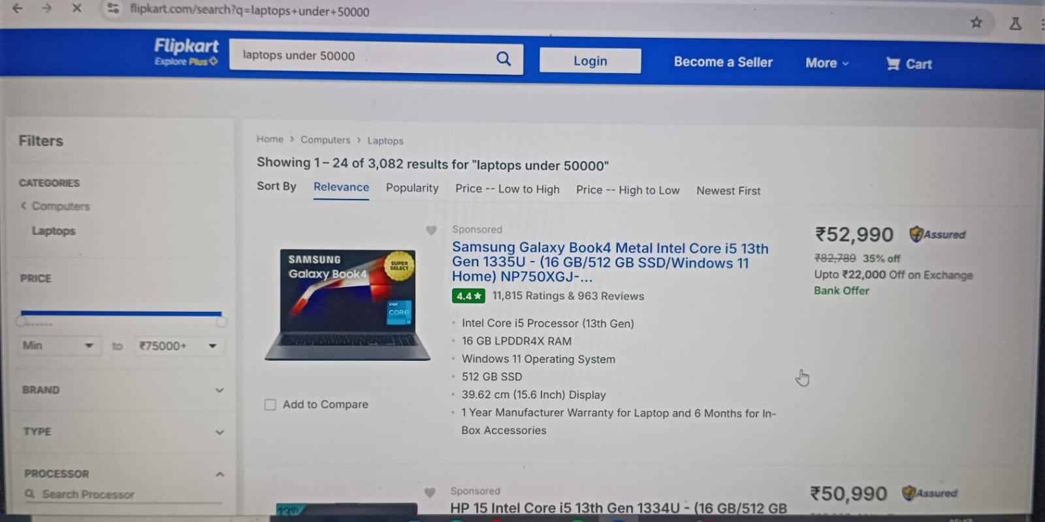

Slide 8

In the end, our Web Navigator AI Agent successfully takes a natural language query, processes it, and displays clean structured results on the output page. This confirms that the system is working end-to-end — from user input to browser automation to meaningful output."

